Slide 1
Containers & Kubernetes
https://aka.ms/learn-k8s

Slide 2
Software Innovation Collision
Containers
(Standardization of the application packaging)
DevOps
(Optimizing how applications are build, delivered and Managed)
Microservices
(Optimizing how applications are composed)
Better Software
Kubernetes Orchestration
(Efficient ways to deliver Infrastructure for Applications)

Slide 3
Azure Overview
Notes:
There is more….
3. Power BI Desktop is a visual data exploration tool that enables you to analyze data and create stunning reports. With Power BI Desktop, you are able to:
Acquire and prepare data using extensive query capabilities.
Manipulation and consolidation of multiple data sources is performed in Power BI Desktop – this enables Power BI service users to use data from multiple sources in a single report.
Establish data structure, then transform and analyze data.
Visualize and explore your data in new ways through a freeform drag-and-drop canvas.
Author reports with a broad range of modern data visualizations.
Publish beautiful, interactive reports directly to powerbi.com.
Securely share reports through unique, curated content library approach.
4. Finally, the Power BI Platform allows you to embed, extend, and integrate Power BI into other applications and environments.

Slide 4


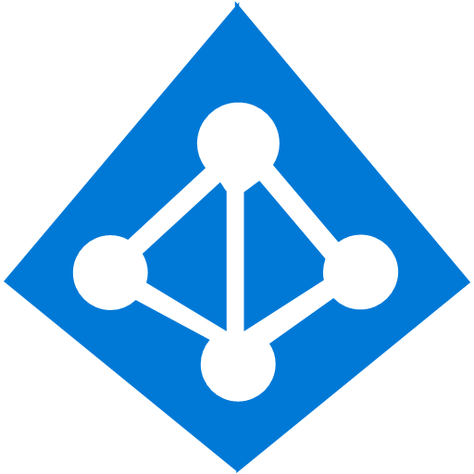

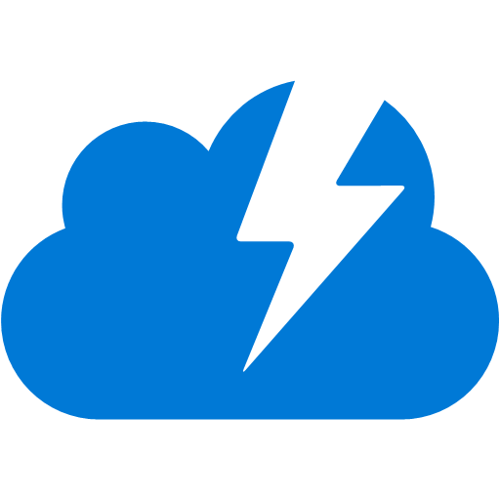
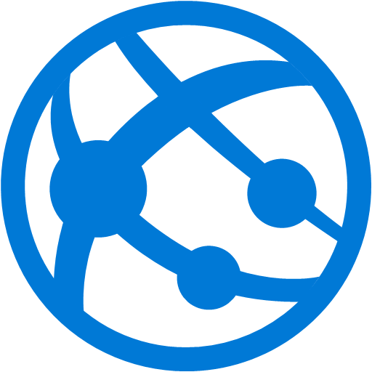


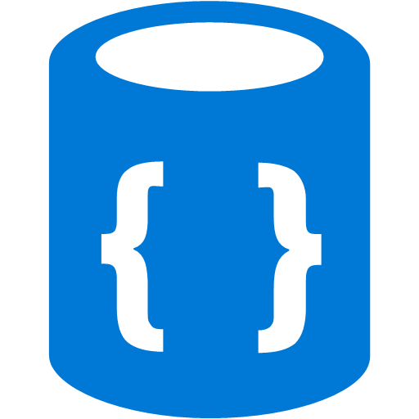




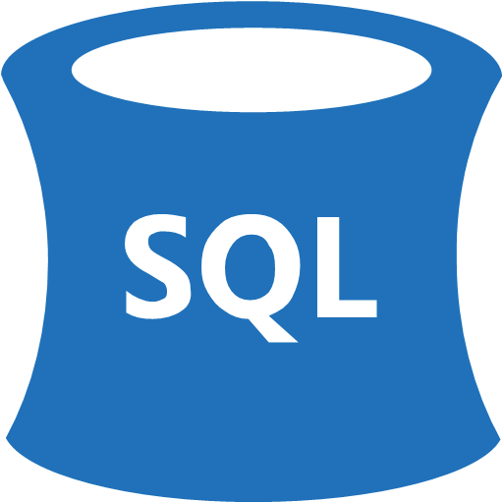


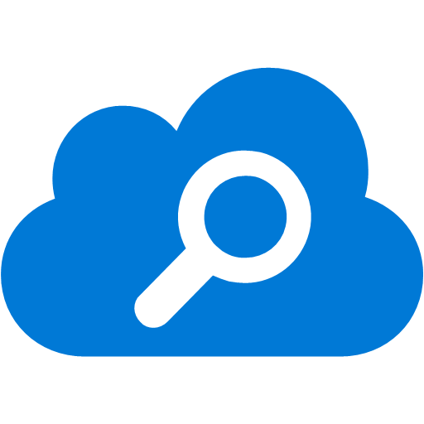
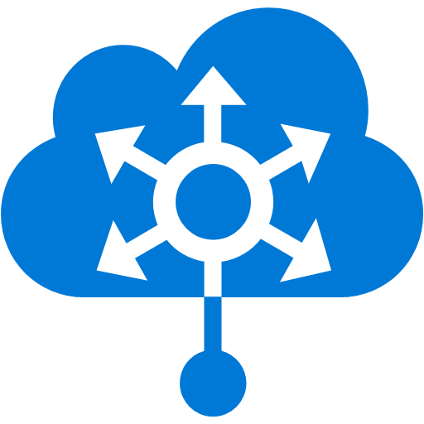
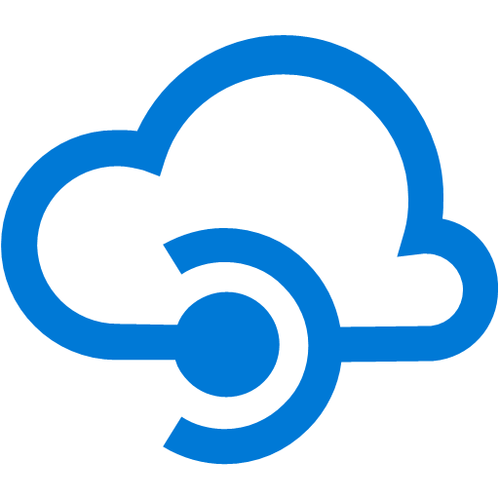




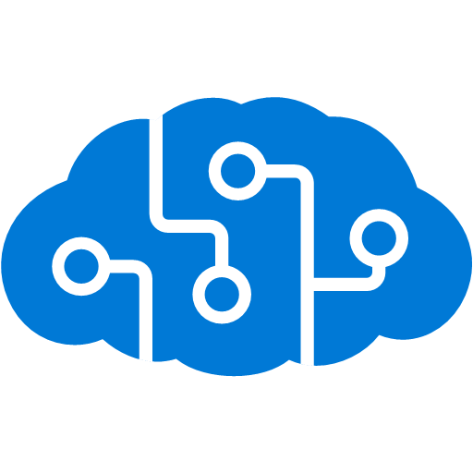


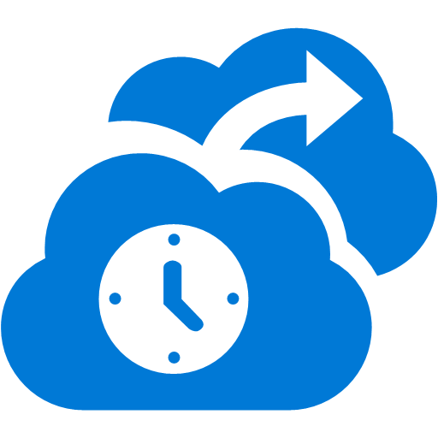
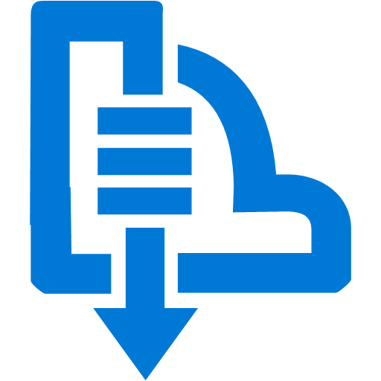


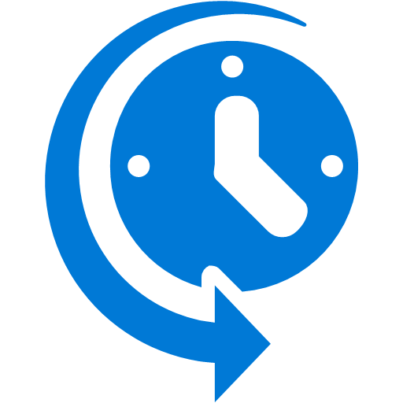



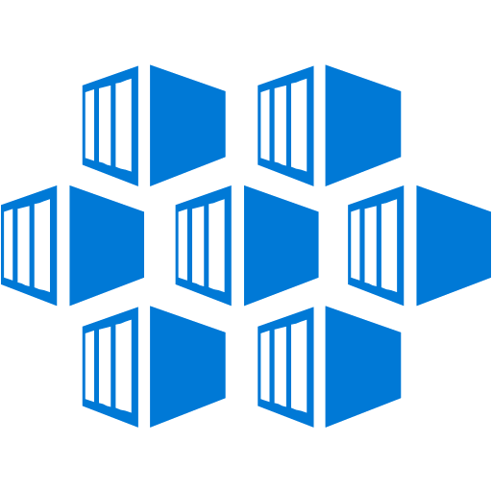

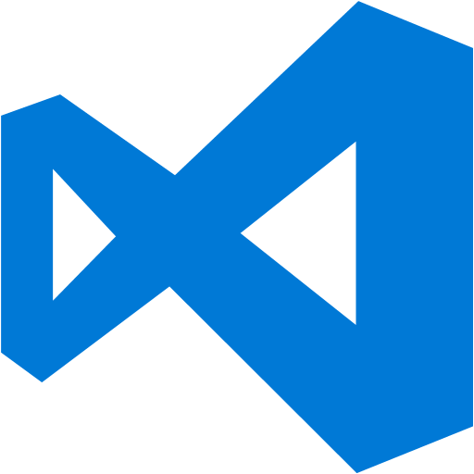


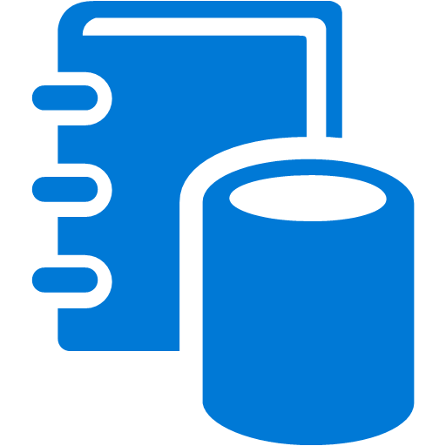

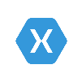
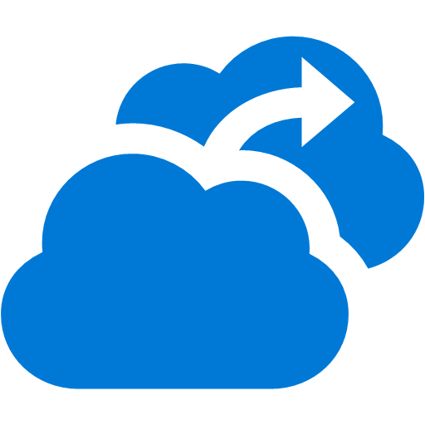




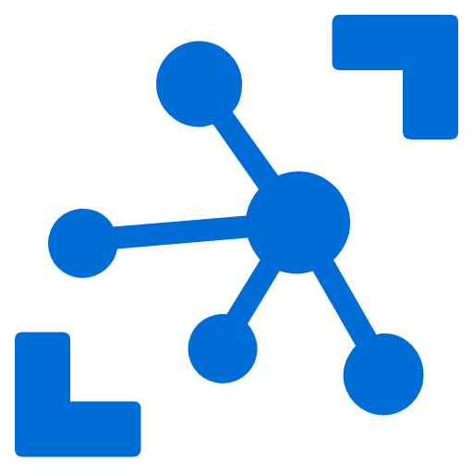
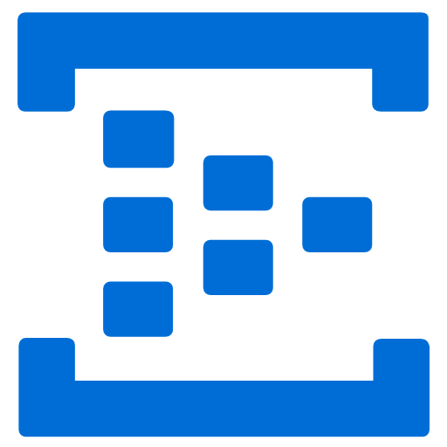



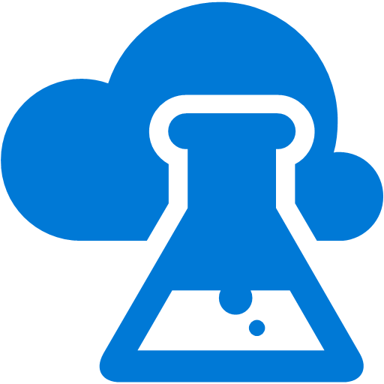
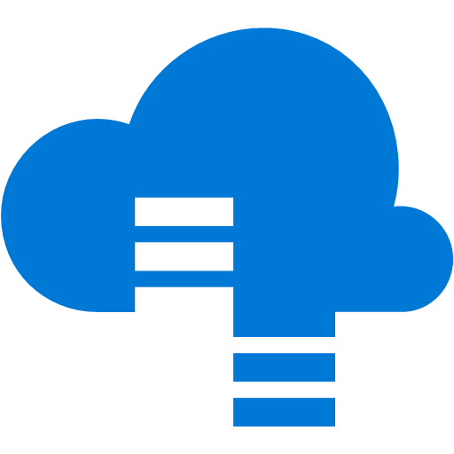


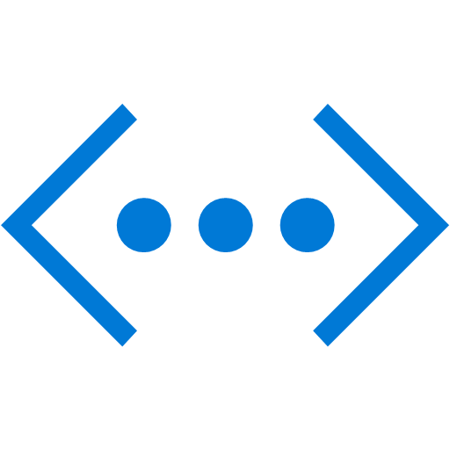
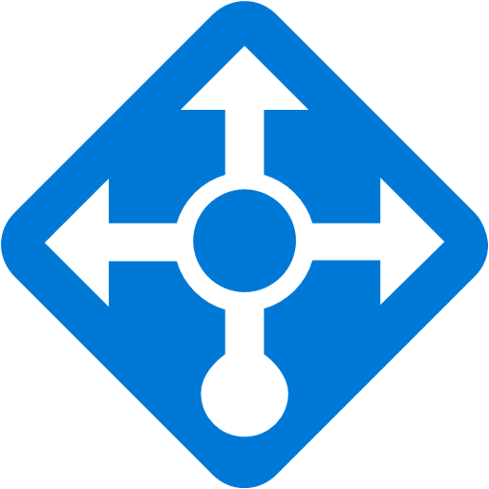

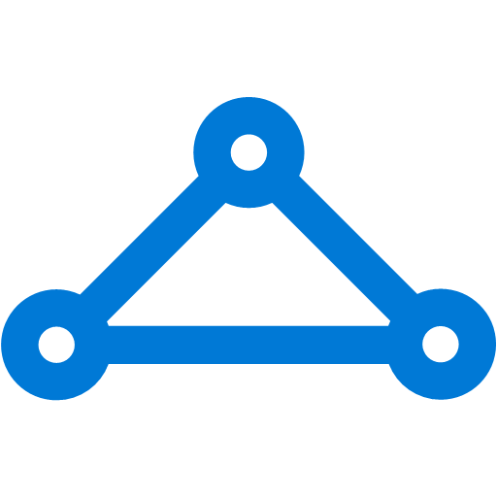
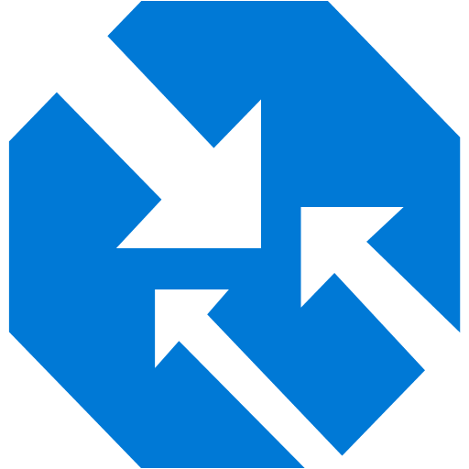
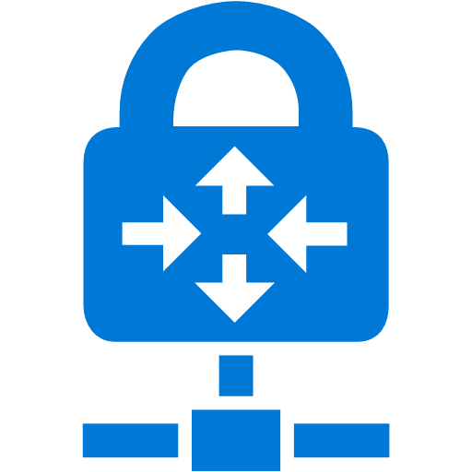
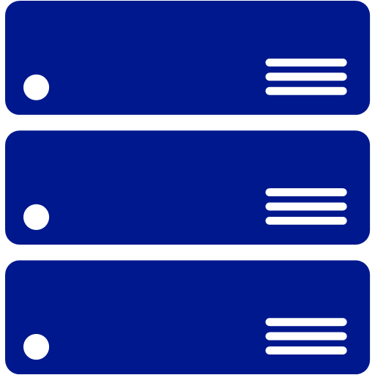
Platform Services
Security & Management
Hybrid
Cloud
Media & CDN
Application Platform
Data
Security Center
Content Delivery
Network
SQL
Database
Azure AD
Health Monitoring
Media Services
Media Analytics
Web
Apps
Mobile
Apps
SQL Data
Warehouse
CosmosDB
Portal
AD Privileged
Identity
Management
Azure Active
Directory
Integration
API
Apps
Cloud
Services
SQL Server
Stretch Database
Redis
Cache
Storage
Tables
Azure
Search
Azure AD
B2C
API
Management
BizTalk
Services
Domain Services
Service
Fabric
Notification
Hubs
Intelligence
Multi-Factor
Authentication
Logic
Apps
Service Bus
Functions
Cognitive Services
Bot Framework
Cortana
Backup
Automation
Developer Services
Analytics & IoT
Operational
Analytics
Compute Services
Scheduler
HDInsight
Machine
Learning
Stream Analytics
Container
Service
VM
Scale Sets
Visual Studio
Mobile
Engagement
Import/Export
Key Vault
Data
Catalog
Data Lake
Analytics Service
Data Lake Store
Store/
Marketplace
Batch
RemoteApp
VS Team Services
Xamarin
Azure Site
Recovery
Application
Insights
HockeyApp
IoT Hub
Event
Hubs
Data
Factory
Power BI
Embedded
VM Image Gallery
& VM Depot
Dev/Test Lab
StorSimple
Infrastructure Services
Compute
Storage
Networking
Virtual Machines
Containers
Blob
Queues
Files
Disks
Virtual Network
Load Balancer
DNS
Express
Route
Traffic Manager
VPN Gateway
App
Gateway
Datacenter Infrastructure
Notes:
Why this Slide:
It shows we have a very broad platform. It about BOTH IaaS and PaaS, that these work together. It shows that we continue to lead in world class IT capabilities and that there’s really nothing missing.
Key Points:
We have already seen how the Azure Platform is IaaS + Pass – but I want you to understand that this is a huge number of capabilities – IT building blocks if you will.
Every one of these blocks you provision anytime, self-service anywhere in the world 24x7. You pay for what you use, you can get more or less anytime and you can fully automate everything…
DON’T spent too much time on this slide – you are going to DEMO (aren’t you!!!)… DON’T go through each block…
Transition to NEXT Slide: Make the build go backwards to show JUST IaaS and then you will go to the demo to show it.

Slide 5
Application maturity model
On-Premises
Infrastructure Platform
IaaS
Infrastructure Platform
CaaS
Container Platform
PaaS
Application Platform
FaaS
Serverless Platform
App Lift & Shift
Re-host your applications from on-premise to cloud
App Modernization
Re-architect for the cloud with PaaS and containers
Modern Apps
Transform app experiences with new cloud native services and AI
Notes:
Implication is that left-to-right increases the level of modernization
Lift and Shift
Can be first step into the cloud
Maybe redeploy to CaaS instead of PaaS
App Modernization
Rearchitecting existing applications to take advantage of higher-level services (PaaS, FaaS)
DevOps can play a bigger role
Modern Apps
Born in the cloud
Cost savings
Reduced IT resources
Reduced cloud spend

Slide 6
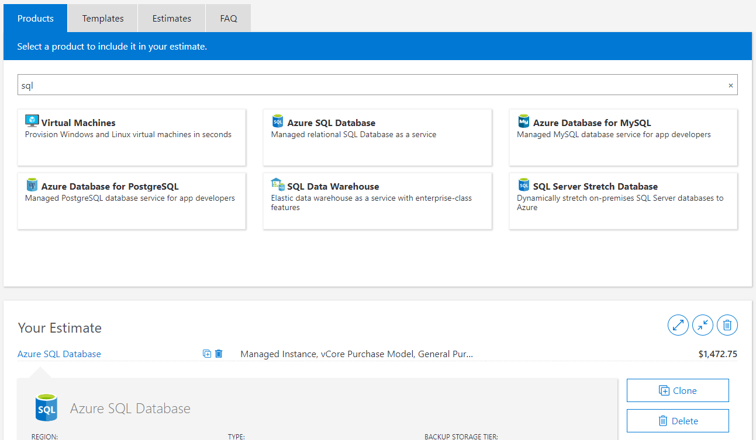
Pricing
https://azure.microsoft.com/en-us/pricing/calculator/
Notes:
Implication is that left-to-right increases the level of modernization
Lift and Shift
Can be first step into the cloud
Maybe redeploy to CaaS instead of PaaS
App Modernization
Rearchitecting existing applications to take advantage of higher-level services (PaaS, FaaS)
DevOps can play a bigger role
Modern Apps
Born in the cloud
Cost savings
Reduced IT resources
Reduced cloud spend

Slide 7
Containerization
Notes:
There is more….
3. Power BI Desktop is a visual data exploration tool that enables you to analyze data and create stunning reports. With Power BI Desktop, you are able to:
Acquire and prepare data using extensive query capabilities.
Manipulation and consolidation of multiple data sources is performed in Power BI Desktop – this enables Power BI service users to use data from multiple sources in a single report.
Establish data structure, then transform and analyze data.
Visualize and explore your data in new ways through a freeform drag-and-drop canvas.
Author reports with a broad range of modern data visualizations.
Publish beautiful, interactive reports directly to powerbi.com.
Securely share reports through unique, curated content library approach.
4. Finally, the Power BI Platform allows you to embed, extend, and integrate Power BI into other applications and environments.

Slide 8
Virtualization versus containerization?
Virtual machine
Container
Application XYZ
Application
App dependencies
Dependencies
Guest OS
Image
C
C
C
C
C
VM
VM
VM
VM
VM
VM
Dependency 1
Dependency 2
Hypervisor 2
Docker Engine
Hypervisor 1
Host OS
Host OS
Hardware
Hardware
Hardware
Type 1
Type 2
Virtualization
Containerization

Slide 9
The benefits of using containers
Agility
Ship apps faster
Portability
Easily move workloads
Density
Achieve resource efficiency
Rapid scale
Scale easily to meet demand

Slide 10


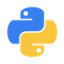
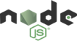
The benefits of using containers
Any OS
Anywhere
Any app
Any language
Java
Linux
On-premises
Monolith
.Net
Python
Windows
Cloud
Microservice
Node

Slide 11
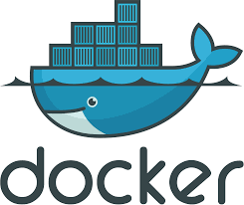
Docker
Docker is a computer program that performs operating-system-level virtualization, also known as "containerization". It was first released in 2013 and is developed by Docker, Inc.
Docker is used to run software packages called "containers". In a typical example use case, one container runs a web server and web application, while a second container runs a database server that is used by the web application.
Launched in March 2013
Over 100 million+ Downloads
Over 75K+ Docker-ized applications
100+ Case Studies worldwide
https://en.wikipedia.org/wiki/Docker_(software)

Slide 12
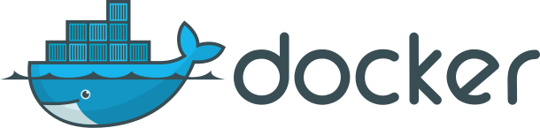
What is ?
An open source container runtime
Mac, Windows and Linux support
# Worlds simplest Dockerfile
$ cat Dockerfile
FROM scratch
COPY hello /
CMD ["/hello"]
# Create a docker image named hello-world and tagged latest
$ docker build –t hello-world:v1.1.1 .
# And run it…
$ docker run hello-world:latest

Slide 13
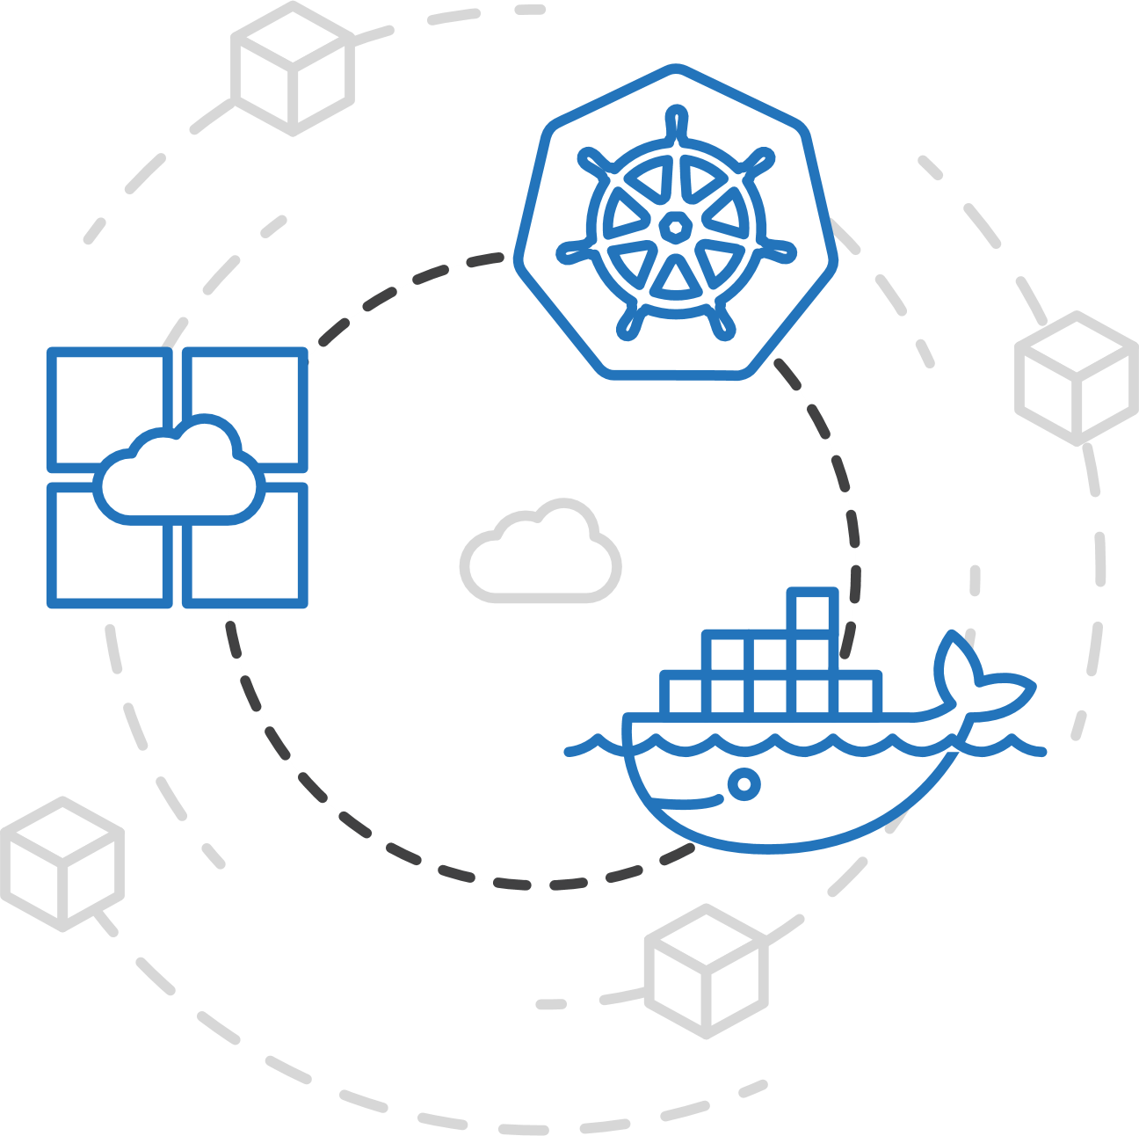
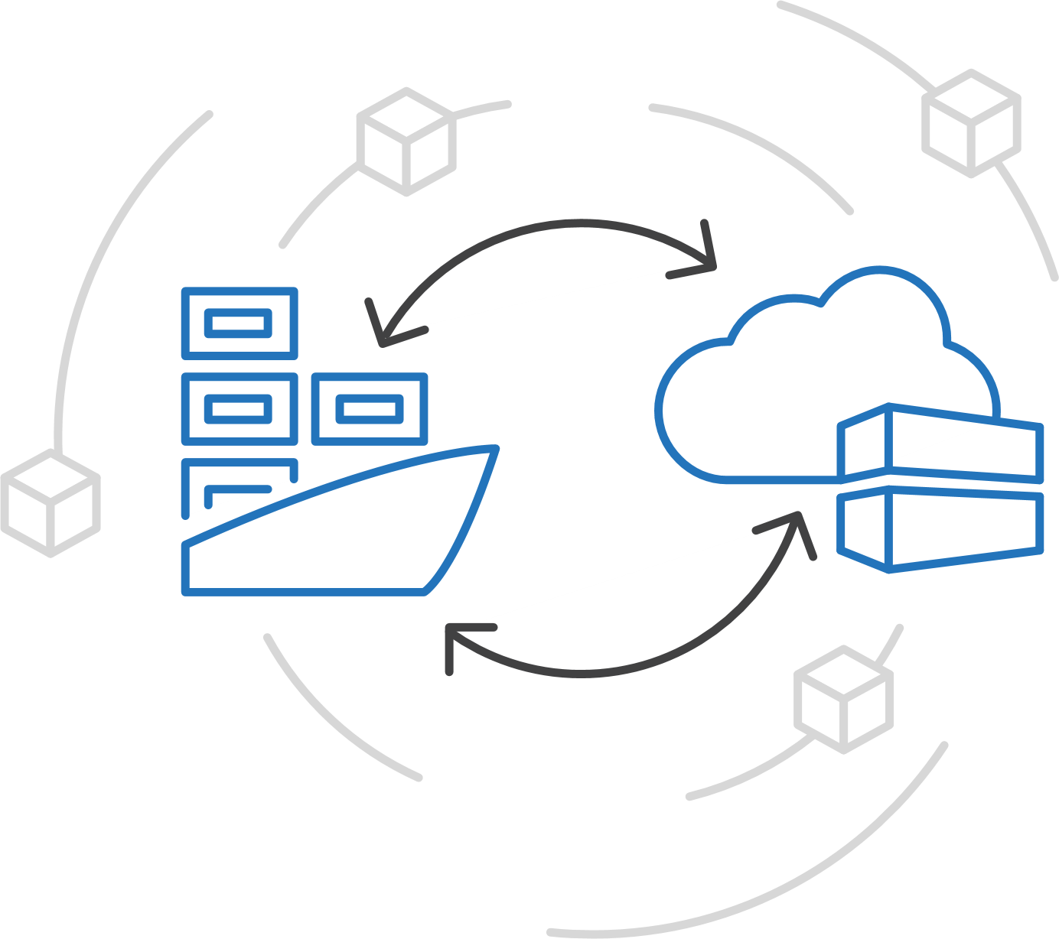
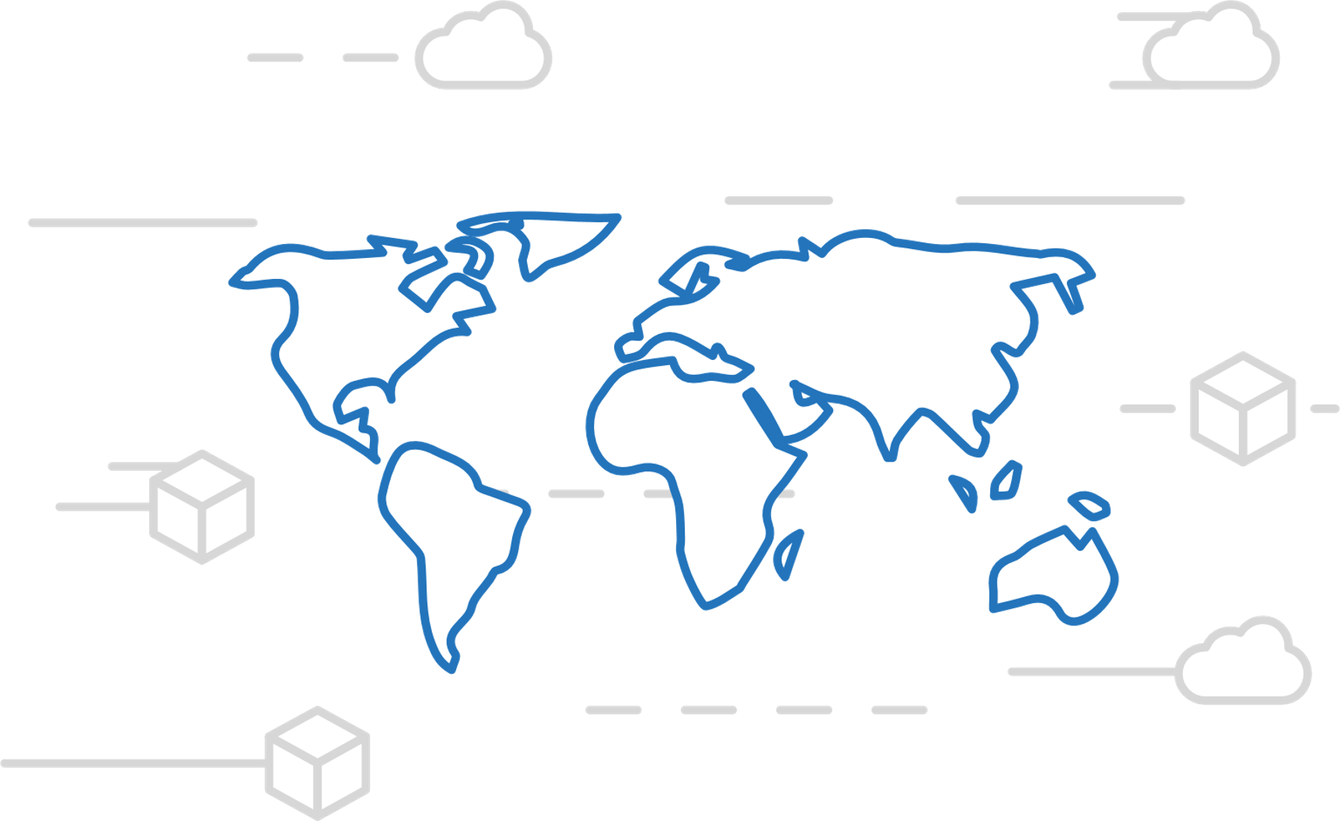
Azure Container Registry
Manage a Docker private registry as a first-class Azure resource
Manage images for all types of containers
Use familiar, open-source Docker CLI tools
Azure Container Registry geo-replication

Slide 14
Kubernetes / AKS
Notes:
There is more….
3. Power BI Desktop is a visual data exploration tool that enables you to analyze data and create stunning reports. With Power BI Desktop, you are able to:
Acquire and prepare data using extensive query capabilities.
Manipulation and consolidation of multiple data sources is performed in Power BI Desktop – this enables Power BI service users to use data from multiple sources in a single report.
Establish data structure, then transform and analyze data.
Visualize and explore your data in new ways through a freeform drag-and-drop canvas.
Author reports with a broad range of modern data visualizations.
Publish beautiful, interactive reports directly to powerbi.com.
Securely share reports through unique, curated content library approach.
4. Finally, the Power BI Platform allows you to embed, extend, and integrate Power BI into other applications and environments.

Slide 15
Kubernetes: the industry leading orchestrator
Portable
Public, private, hybrid, multi-cloud
Extensible
Modular, pluggable, hookable, composable
Self-healing
Auto-placement, auto-restart, auto-replication, auto-scaling
Notes:
Why did Kubernetes win?
Until about 18 months ago, the container orchestration space was competitive
Docker Swarm, Mesosphere DC/OS, and Kubernetes (among others) were vying for share
The original Azure Container Service reflected this market dynamic, with the choice of orchestrator
Kubernetes began to pull away around the end of 2016
Now, all cloud providers offer a managed Kubernetes service and even Docker and DC/OS integrate Kubernetes
Why?
Community: the project was donated to an OSS foundation (the Cloud Native Computing Foundation) very early on and other major players (notably Red Hat) got involved early, separating it from its Google roots and avoiding lock-in concerns
Container-native: some orchestrators (namely DC/OS) added containers to an existing scheduling technology, which is more flexible but can feel ‘tacked-on’
Built from best practices learned at scale: Kubernetes was inspired by Google’s internal scheduler Borg and incorporated the learnings from it. Other projects (especially Swarm) did not have that maturity.
Why Kubernetes won doesn’t actually matter
Its network effects are now so strong that competitors are struggling to stay relevant even if they are objectively ‘better’ in some respects

Slide 16
How managed Azure Kubernetes Service works
Azure managed control plane
Automated upgrades, patches
High reliability, availability
Easy, secure cluster scaling
Self-healing
API server monitoring
At no charge
App/ workload definition
Self-managed master node(s)
Kubernetes API endpoint
etcd Store
User
API server
Scheduler
Controller Manager
Cloud Controller
Schedule pods over private tunnel
Customer VMs
Docker
Docker
Docker
Docker
Docker
Pods
Pods
Pods
Pods
Pods
Notes:
A Kubernetes cluster is typically made up of
Master nodes for system components like the API server, etcd store, and scheduler
Agent nodes for user container workloads
Managing the cluster involves:
Monitoring the API server
Ensuring HA/DR for the etcd store
Safely managing upgrades across Kubernetes versions
Safely scaling the cluster in and out
Patching master and agent VM nodes
And on and on…
This is complex, error-prone, and expensive
A managed service like AKS moves those tasks to the cloud provider

Slide 17
Kubernetes 101
Internet
Kubernetes control
Worker node
kubelet
kube-proxy
Kubernetes users communicate with API server and apply desired state
Master node
Docker
Prod
Prod
Master nodes actively enforce desired state on worker nodes
API server
Containers
Containers
Worker nodes support communication between containers
-controller-manager
-scheduler
Worker node
kubelet
kube-proxy
Worker nodes support communication from the Internet
replication, namespace, serviceaccounts, etc.
etcd
Docker
Prod
Prod
Containers
Containers

Slide 18
Kubernetes Order of Operations
1.) Networking – Azure CNI, Kubenet, Public/Private, VNET, Subnet Sizes, Egress, NAT, Network Policy, DNS
2.) Security – RBAC, Private Cluster, API Whitelist, Pod Identity, Security Center
3.) Traffic – Ingress, Service Mesh, Policy, mTLS, SLOs
4.) Monitoring – Prometheus/Grafana, Container Insights
5.) Operations – Requests, Limits, Namespaces, Flux, Terraform, OAM, CNAB, CI/CD, Helm
6.) Development – Container Registry, Secrets, Volumes, Liveness/Readiness, Dapr

Slide 19
Kubernetes Walk Through
1.) Terminology and Overview
2.) Setting up a Cluster
3.) Working with your Cluster
4.) Deploying Workloads to Kubernetes
5.) Scalability
6.) Advanced Topics

Slide 20
Advanced Topics
Notes:
There is more….
3. Power BI Desktop is a visual data exploration tool that enables you to analyze data and create stunning reports. With Power BI Desktop, you are able to:
Acquire and prepare data using extensive query capabilities.
Manipulation and consolidation of multiple data sources is performed in Power BI Desktop – this enables Power BI service users to use data from multiple sources in a single report.
Establish data structure, then transform and analyze data.
Visualize and explore your data in new ways through a freeform drag-and-drop canvas.
Author reports with a broad range of modern data visualizations.
Publish beautiful, interactive reports directly to powerbi.com.
Securely share reports through unique, curated content library approach.
4. Finally, the Power BI Platform allows you to embed, extend, and integrate Power BI into other applications and environments.

Slide 21
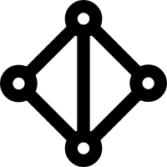
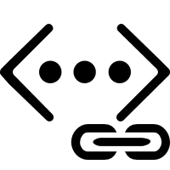
Secure network communications with VNET and CNI
Uses Azure subnet for both your containers and cluster VMs
1
On-premises infrastructure
3
Azure VNet A
Enterprise system
Allows for connectivity to existing Azure services in the same VNet
Backend services subnet
AKS subnet
Azure Express Route
AKS cluster
SQL Server
Use Express Route to connect to on-premises infrastructure
Azure SQL PaaS DB
5
Use VNet peering to connect to other VNets
2
Service Endpoint
Connect AKS cluster securely and privately to other Azure resources using VNet endpoints
VNet peering
Other peered VNets
4
AKS VNet integration works seamlessly with your existing network infrastructure

Slide 22


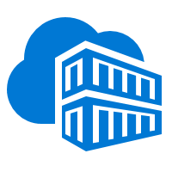

Security overview
Internal User
External User
Azure Container Registry
App Gateway
Developer
AKS with RBAC
͏Image and container level security
AAD authenticated Container registry access
ACR image scanning and content trust for image validation
1
Internal Load Balancer
External Load Balancer
͏Node and cluster level security
Automatic security patching nightly
Nodes deployed in private virtual network subnet w/o public addresses
Network policy to secure communication paths between namespaces (and nodes)
Pod Security Policies
K8s RBAC and AAD for authentication
Azure VNet
Active Directory
Ingress Controller
Ingress Controller
External DNS
Kubernetes Admin
Node
Node
Pod
Pod
3
2
͏Pod level security
Pod level control using AAD Pod Identity
Pod Security Context
AAD Pod Identity
Azure Key Vault
4
͏Workload level security
Azure Role-based Access Control (RBAC) & security policy groups
Secure access to resources & services (e.g. Azure Key Vault) via Pod Identity
Storage Encryption
App Gateway with WAF to protect against threats and intrusions
Azure Storage
SQL Database
Cosmos DB
Encrypted Storage

Slide 23
Identity and access management through AAD and RBAC
A developer authenticates to the AAD token issuance endpoint and requests an access token
Azure Active Directory
The AAD token issuance endpoint issues the access token
1
The access token is used to authenticate to the secured resource
Developer
Token
2
AKS
Data from the secured resource is returned to the web application
3
Token
4
Azure delivers a streamlined identity and access management solution with Azure Active Directory (AAD) and Azure Kubernetes Services (AKS)

Slide 24
Policy controller
Admin adds policy for the cluster
Admin
User
Admin
Admin audits compliance of the cluster using /audit endpoint
3
Run audit
2
Create + Update
Policy as CRDs
1
User uses standard Kubernetes API to operate the cluster and the create actions are guarded by policy
kubernetes-policy-service
/admit
kubernetes-apiserver
4
Kubernetes-policy-controller provides an admission controller webhook that performs evaluations by calling open-policy-agent (OPA) service
/audit
/admit
watch
kubernetes-policy-controller
kubernetes-mgmt
audit
policy-admit
opa-admit
k8s object watcher
policy-crd-watcher
/query
/data
/policy
open-policy-agent

Slide 25
Pod identity
Developer
Kubernetes operator defines an identity map for K8s service accounts
<\>
Node Managed Identity (NMI) watches for mapping reaction and syncs to Managed Service Identify (MSI)
3
Kubernetes
Kubernetes controller
Azure Identity Binding
Azure SQL Server
Developer creates a pod with a service account, and pod uses standard Azure SDK to fetch a token bound to MSI
1
Pod
Pod uses access token to consume other Azure services; services validate token
Active Directory Pod Identity
Token
Azure MSI
4
NMI + EMSI
2

Slide 26


Azure Monitor for containers
Visualization
Visualize overall health and performance from clusters to containers with drill downs and filters
Observability
Insights
Provide insights with multi-cluster health roll up view
Azure Pipelines
Kubernetes control
Azure Monitor for containers
Monitor & Analyze
Monitor and analyze Kubernetes and container deployment performance, events, health, and logs
NEW!
Response
Native alerting with integration to issue managements and ITSM tools
ACI burst from AKS
Observability
Observe live container logs on container deployment status

Slide 27
AKS virtual node
Elastically provision additional compute capacity in seconds
VM
VM
Pods
Pods
Azure Container Instances (ACI)
Application Architect
Pods
Kubernetes control pane
Infrastructure Architect
Deployment/tasks
Virtual node
VM
VM
Pods
Pods

Slide 28

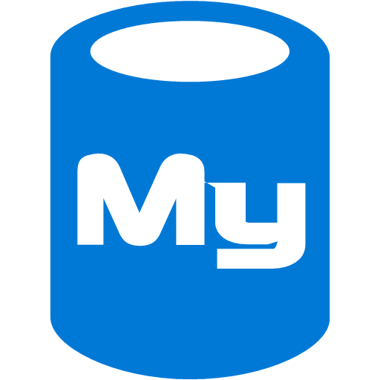




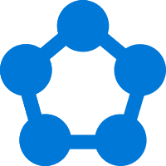
Open Service Broker for Azure
Easily access to SLA-backed Azure Services such as Azure Database for MySQL
SQL Database
Event Hubs
Redis Cache
MySQL Database
Cosmos DB
Service Bus
PosgreSQL Database
Azure Storage
Open Service Broker for Azure (OSBA)
Cloud Foundry
Service Fabric
OpenShift
Kubernetes

Slide 29






Best support for your enterprise need
Kubernetes 101 Docs aka.ms/LearnAKS
Best practices aka.ms/aks/bestpractices
Hear from experts aka.ms/k8s/lightboard
Case studies aka.ms/aks/casestudy
Microservices architecture aka.ms/aks/microservices
Try for free aka.ms/aks/trial
Feedback on the roadmap? Tell us at https://aka.ms/aks/feedback

Slide 30
Thank you.

